Slide 1

CommissionsReportGenerator
Sole Developer: Dylan Phillips,
Sales Operations Intern at TAARCOM, Inc.
Slides created 7/26/2023
All images in this slideshow are for presentation purposes only. Please do not repost or share any of these images, as they are property of TAARCOM, Inc.
Thank you.

Slide 2
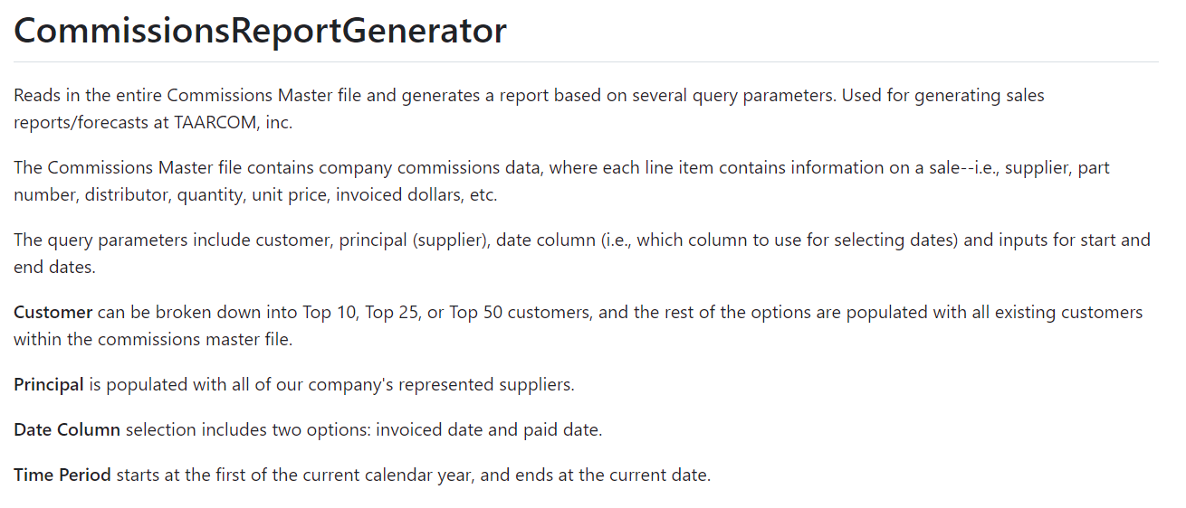

Slide 3
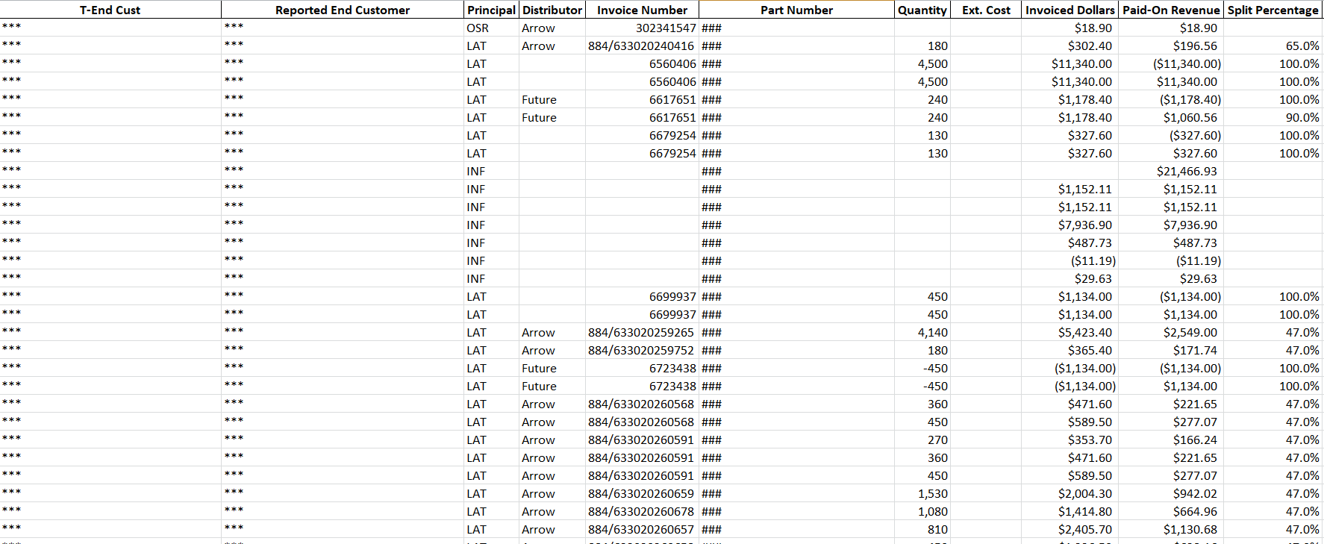
Commissions Master File

Slide 4
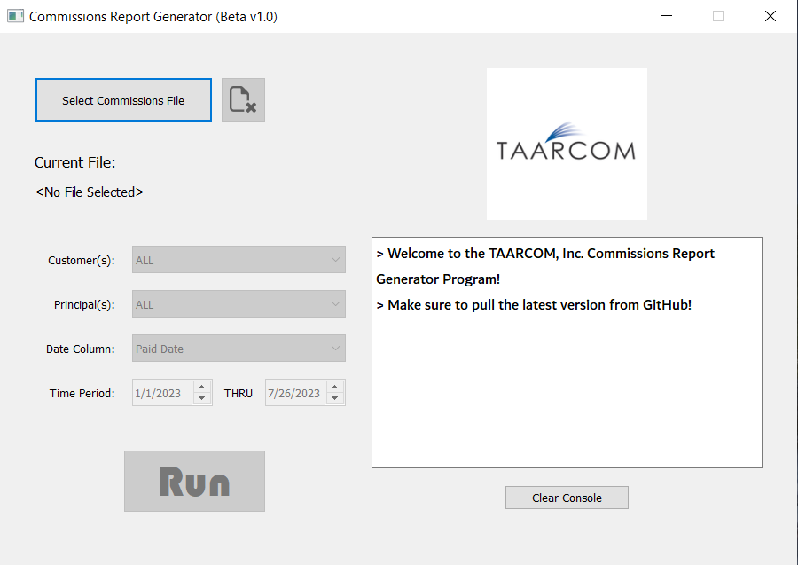
Launch

Slide 5
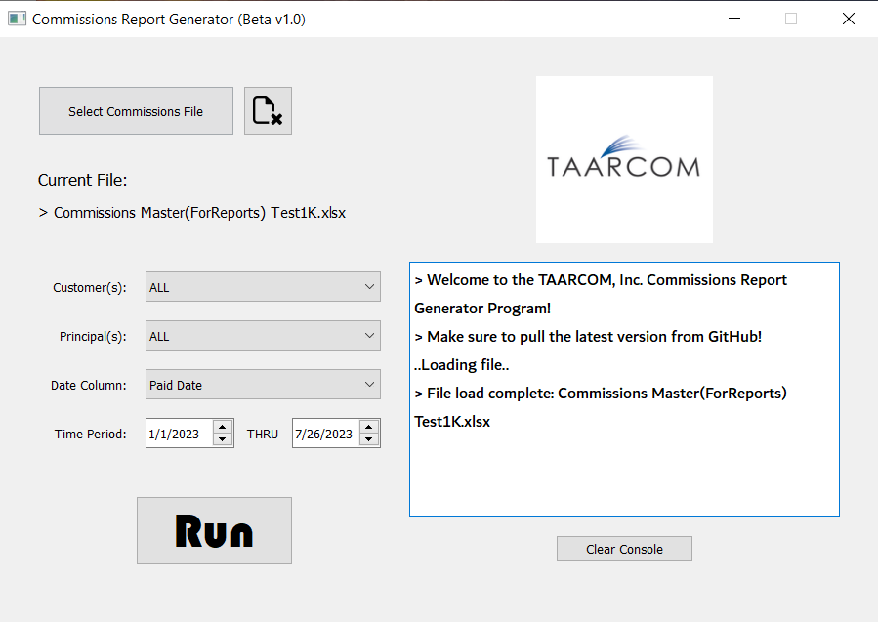
Select File

Slide 6
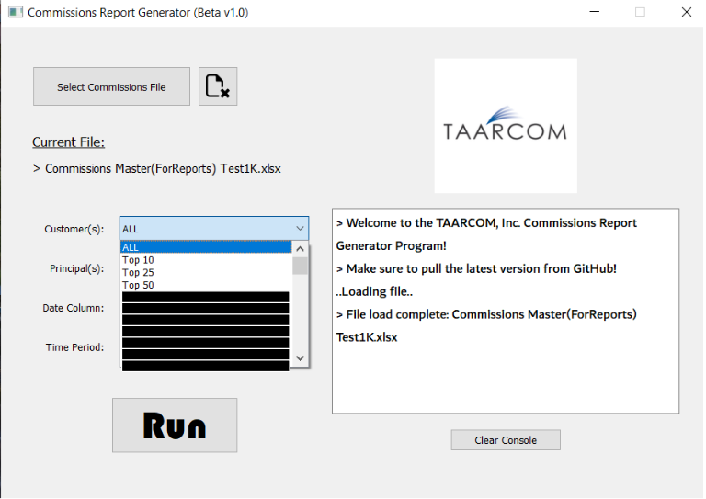
Customer
Drop-Down
** Customer names redacted
** confidential

Slide 7
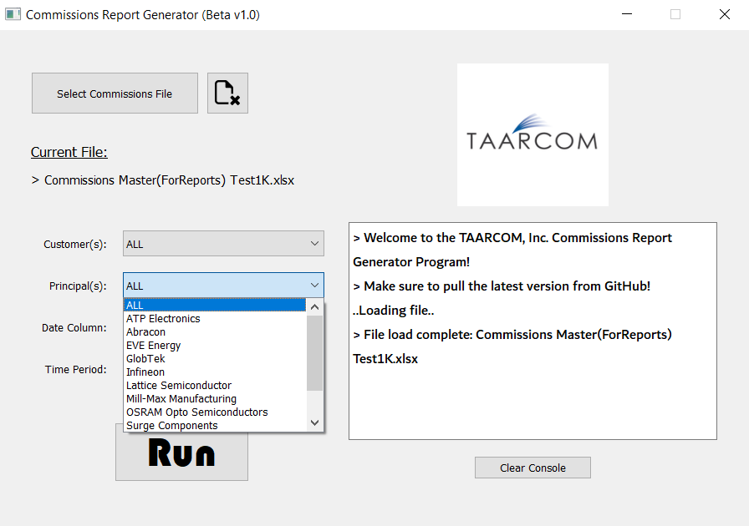
Principal
Drop-Down

Slide 8
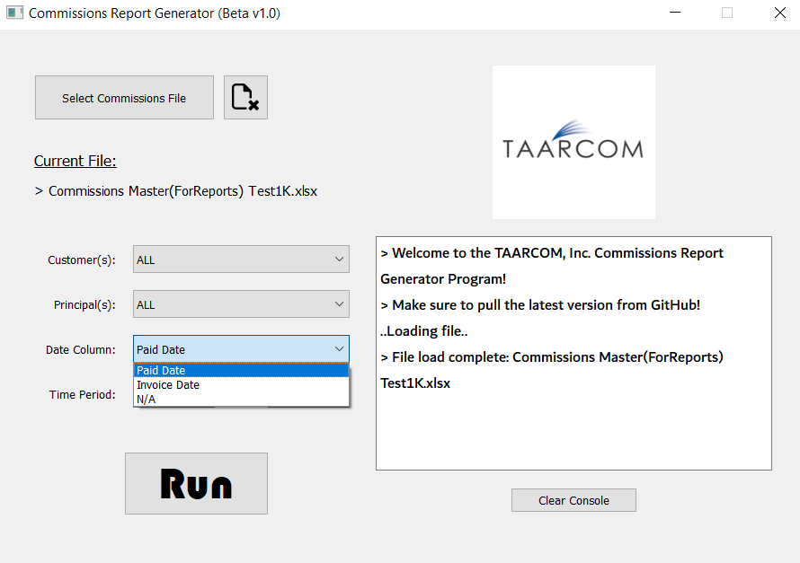
Date Column
Drop-Down

Slide 9
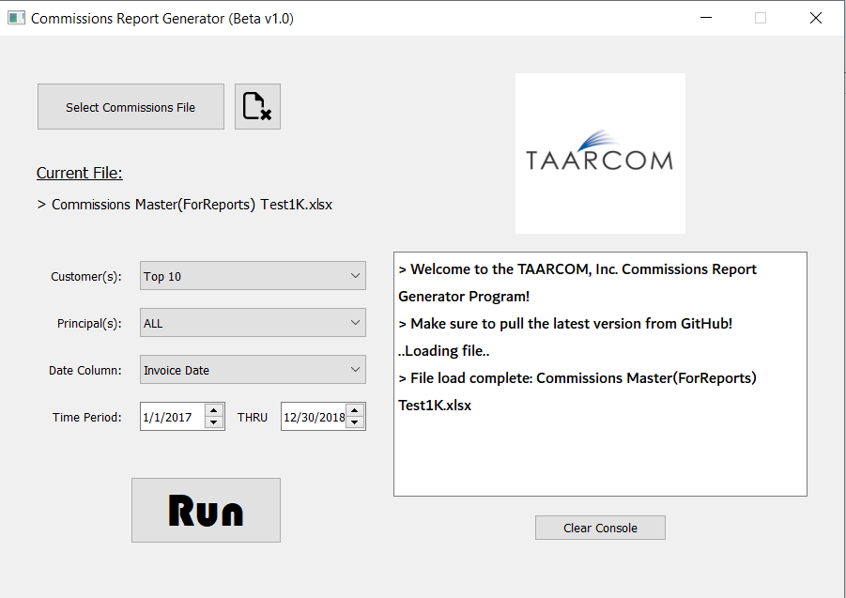
Query Selected

Slide 10
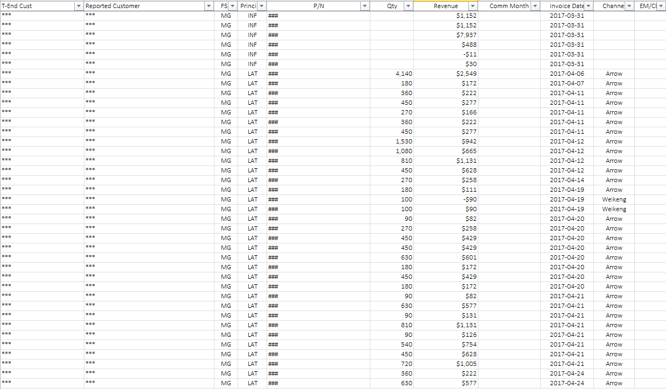
Run Output (Data)

Slide 11
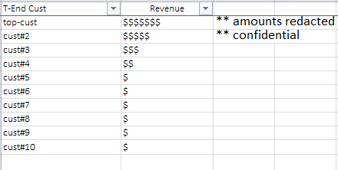
Run Output (Customers Ranked)

